Slide 1
Cornerstone City Church Peninsula Plus Community Hoo Are Ya
10th August 2025

Slide 2
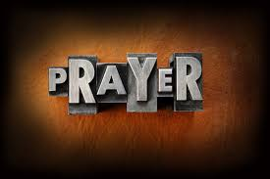

Slide 3
Let Everything That Has Breath
CCLI Song # 2430979
Matt Redman
© 1997 Thankyou Music
For use solely with the SongSelect® Terms of Use. All rights reserved. www.ccli.com
CCLI Licence No. 33265

Slide 4
1/9
Let ev'rything that
Ev'rything that
Ev'rything that has breath
Praise the Lord
(Repeat)

Slide 5
2/9
Praise You in the morning
Praise You in the evening
Praise You when I'm young
And when I'm old

Slide 6
3/9
Praise You when I'm laughing
Praise You when I'm grieving
Praise You ev'ry season of the soul

Slide 7
4/9
If we could see
How much You're worth
Your pow'r Your might
Your endless love
Then surely we would
Never cease to praise

Slide 8
5/9
Let ev'rything that
Ev'rything that
Ev'rything that has breath
Praise the Lord
(Repeat)

Slide 9
6/9
Praise You in the heavens
Joining with the angels
Praising You forever and a day

Slide 10
7/9
Praise You on the earth now
Joining with creation
Calling all the nations to Your praise

Slide 11
8/9
If they could see
How much You're worth
Your pow'r Your might
Your endless love
Then surely we would
Never cease to praise

Slide 12
9/9
Let ev'rything that
Ev'rything that
Ev'rything that has breath
Praise the Lord
(Repeat)

Slide 13
Surrounded (Fight My Battles) CCLI Song # 7098758
Elyssa Smith
© 2017 UR Creative
For use solely with the SongSelect® Terms of Use. All rights reserved. www.ccli.com
CCLI License # 33265

Slide 14
1/2
This is how I fight my battles (3X)
(This is how)
This is how I fight my battles (3X)
(This is how)

Slide 15
2/2
It may look like I'm surrounded
But I'm surrounded by You
It may look like I'm surrounded
But I'm surrounded by You

Slide 17
Lord You Have My Heart
CCLI Song # 1108735
Martin Smith
© 1992 Thankyou Music
For use solely with the SongSelect® Terms of Use. All rights reserved. www.ccli.com
CCLI Licence No. 33265

Slide 18
1/2
Lord You have my heart
And I will search for Yours
Jesus take my life and lead me on
Lord You have my heart
And I will search for Yours
Let me be to You a sacrifice

Slide 19
2/2
And I will praise You Lord
And I will sing of love come down
And as You show Your face
We'll see Your glory here

Slide 21
Worthy
CCLI Song # 7111931
Chris Brown | Mack Brock | Steven Furtick
© Music by Elevation Worship Publishing (Admin. by Essential Music Publishing LLC)
For use solely with the SongSelect® Terms of Use. All rights reserved. www.ccli.com
CCLI Licence No. 33265

Slide 22
1/6
It was my cross You bore
So I could live in the freedom You died for
And now my life is Yours
And I will sing of Your goodness forevermore

Slide 23
2/6
Worthy is Your name, Jesus
You deserve the praise
Worthy is Your name
Worthy is Your name, Jesus
You deserve the praise
Worthy is Your name

Slide 24
3/6
And now my shame is gone
I stand amazed in Your love undeniable
Your grace goes on and on
And I will sing of Your goodness forevermore

Slide 25
4/6
Worthy is Your name, Jesus
You deserve the praise
Worthy is Your name
Worthy is Your name, Jesus
You deserve the praise
Worthy is Your name (REPEAT)

Slide 26
5/6
Be exalted now in the heavens
As Your glory fills this place
You alone deserve our praise
You're the name above all names (REPEAT)

Slide 27
6/6
Worthy is Your name, Jesus
You deserve the praise
Worthy is Your name
Worthy is Your name, Jesus
You deserve the praise
Worthy is Your name

Slide 28


Slide 29
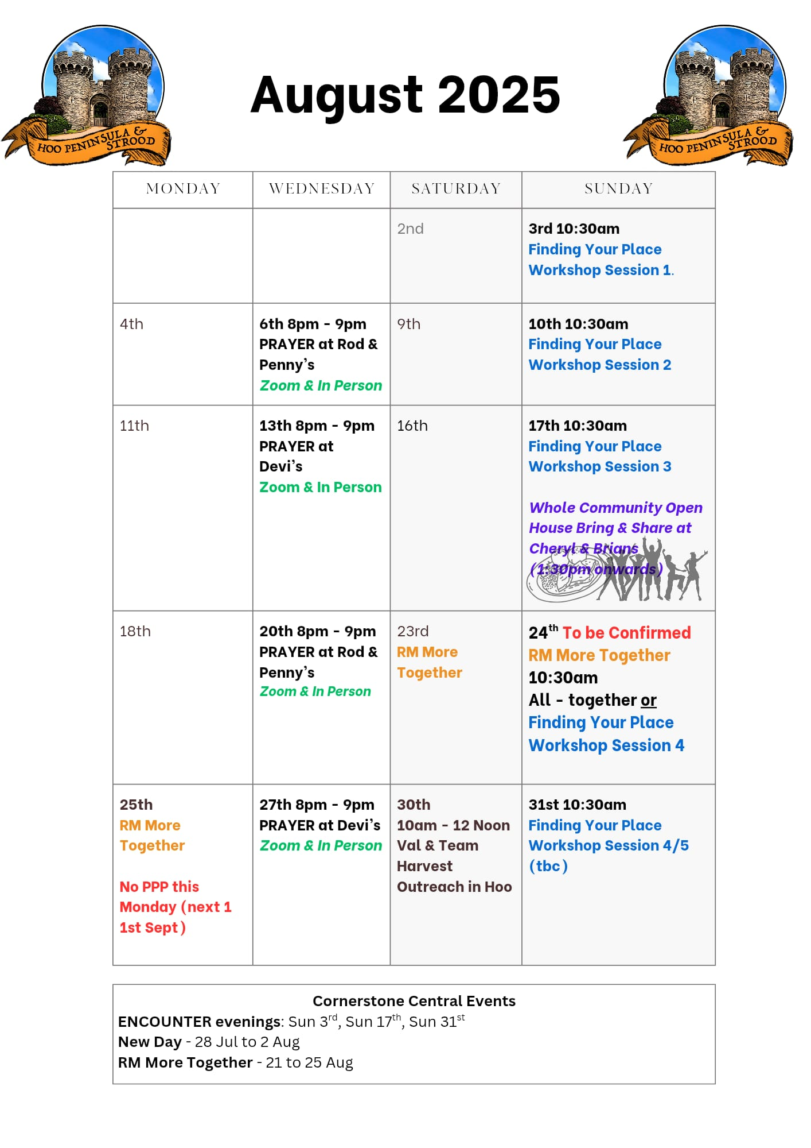

Slide 30


Slide 31

Grow Group 1
On YOUR MARK!

Slide 32
Leaders
Leaderss
Phil & Kim
Maria (Mia) Warren
Matthew Harrison
Richard & Elisha Acheampong
Phil & Kim
Maria (Mia) Warren
Matthew Harrison
Richard & Elisa Acheampong

Slide 33
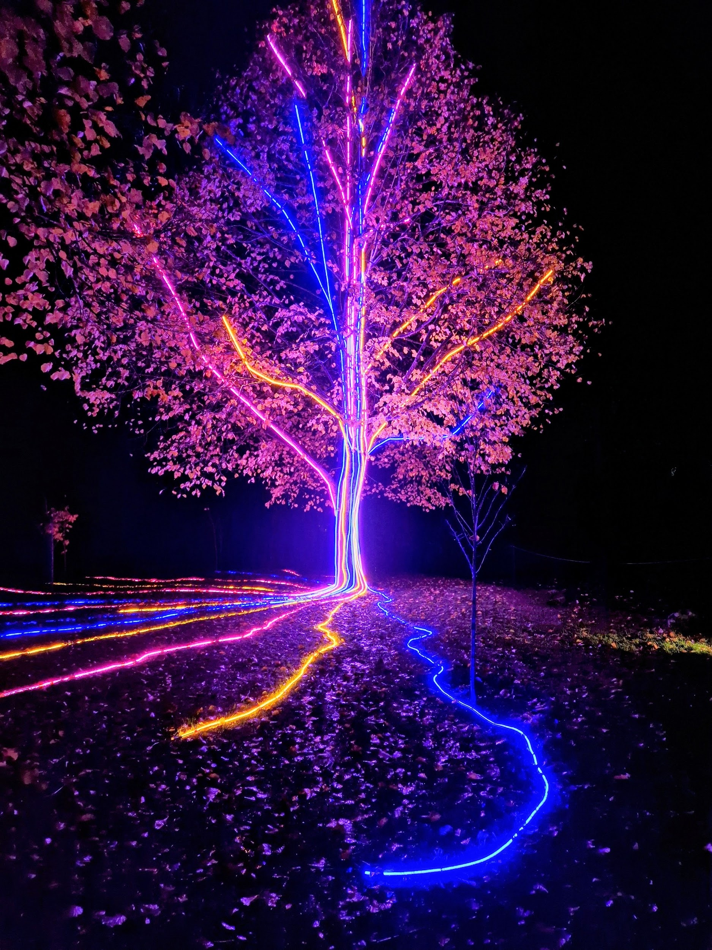
Storm Walker
Storm Walker
Symbolising, trust in Jesus Christ through life's storms.
Mark 4:35-41

Slide 34
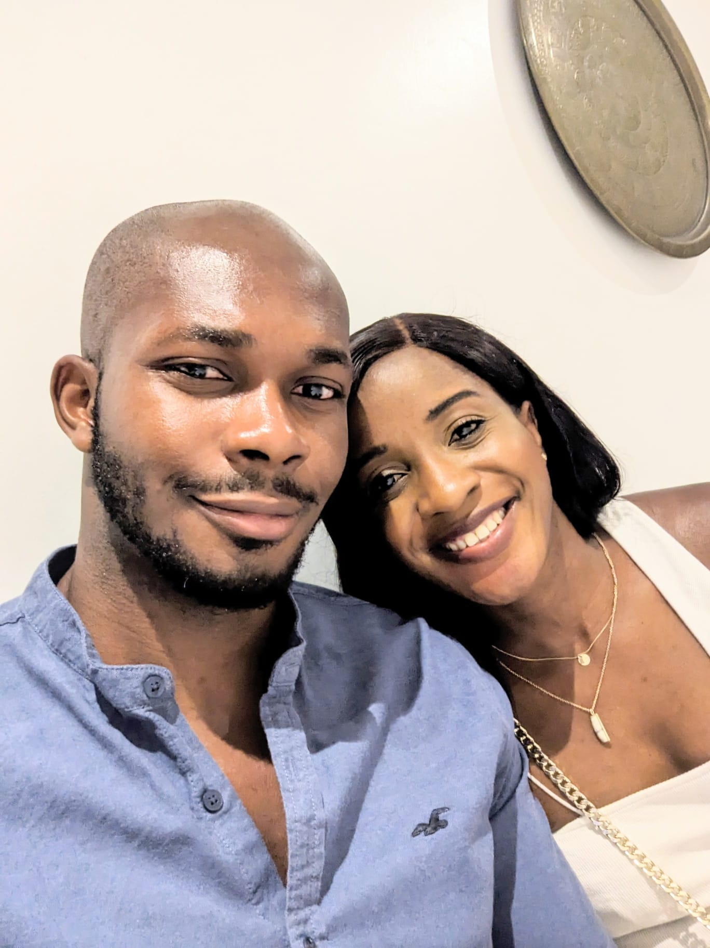


Group Leaders
Micheal and Mwamba
Wilfred and Parveen
Hannah

Slide 35


Slide 36


Slide 37


Slide 38
2 Corinthians 14 May the grace of the Lord Jesus Christ, and the love of God, and the fellowship of the Holy Spirit be with you all
Surely goodness and mercy shall follow us all the days of our lives, and we shall dwell in the house of the Lord forever.

